Slide 1
Weekly Meeting 5/3/2024
JetRacer Soccer League

Slide 2
ROS/Hardware
Previous Work:
Finished ROS groundwork
Completed ZED2 camera swivel script
Started printing chassis
Future Work:
Implement movement strategy
Import custom dataset
Assemble car's upon print finish

Slide 3
Movement Strategy
Continue planning robot movement from CV outputs
Worked on determining movement strategy based on unity model
Developed preliminary strike functionality
Continue to generate movement strategy
Determine method of angle and speed calculation with minimum latency
Test striking capabilities

Slide 4
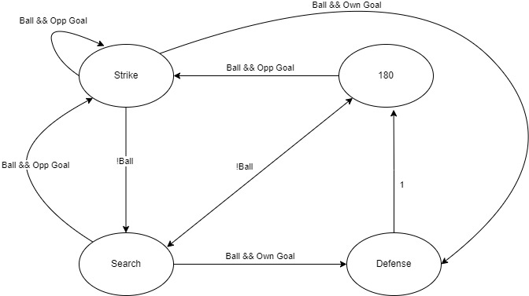

Slide 5
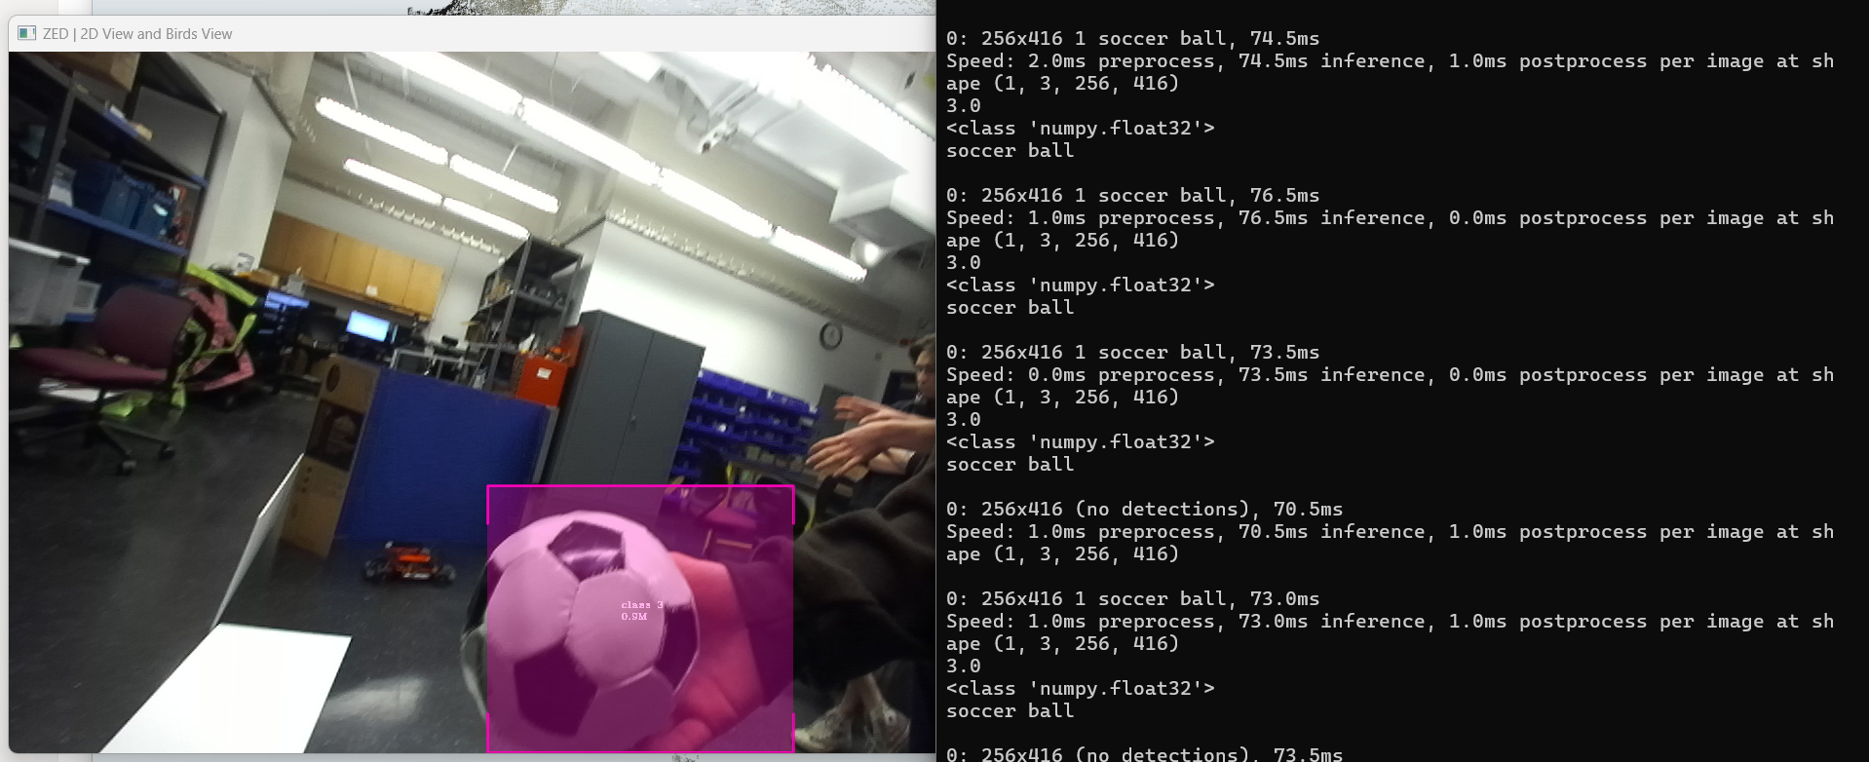
CV
Previous work:
Tested object detection with ZED2 on laptop
Detected all objects, followed the ball well, but switched the red goal and blue goal
Future work:
Update dataset to include blue car

